Slide 1
13-UNIX
Shared Memory
Shared Memory, Message Queues
Chapter 45-46-47-48

Slide 2
Memory Organization for an Executed Program
When a program is loaded into memory, it is organized into three areas of memory, called segments:
text segment (or code segment) is where the compiled code of the program itself resides.
stack segment is where memory is allocated for automatic variables within functions.
heap segment provides more stable storage of data for a program since memory allocated in the heap remains in existence for the duration of a program.
Notes:
Page 115-6 more to add

Slide 3
Stack
Local variables (variables declared inside a function) are put on the stack - unless they are declared as 'static' or 'register‘
Function parameters are allocated on the stack
Local variables that are stored in the stack are not automatically initialized by the system
Variables on the stack disappear when the function exits

Slide 4
Heap
Global, static, register variables are stored on the heap before program execution begins
They exist the entire life of the program (even if scope prevents access to them - they still exist)
They are initialized to zero
Global variables are on the heap
Static local variables are on the heap (this is how they keep their value between function calls)
Memory allocated by new, malloc, calloc, etc., are on the heap

Slide 5
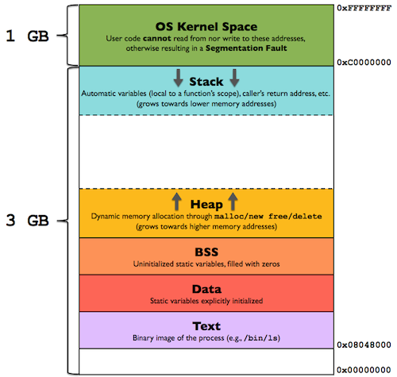
A typical Memory Layout on Linux X86/32

Slide 6
Shared Memory
Normally, the Unix kernel prohibits one process from accessing (reading, writing) memory belonging to another process.
Sometimes, however, this restriction is inconvenient.
At such times, System V IPC Shared Memory can be created to specifically allow one process to read and/or write to memory created by another process

Slide 7
Shared Memory
Common chunk of read/write memory
among processes
MAX
Shared Memory
(unique key)
Create
ptr
ptr
Attach
0
Attach
Proc. 1
Proc. 5
ptr
ptr
ptr
Proc. 2
Proc. 3
Proc. 4

Slide 8
Advantages of Shared Memory
Random Access
you can update a small piece in the middle of a data structure, rather than the entire structure.
Very fast: accessed just like regular memory
Efficiency
unlike message queues and pipes, which copy data from the process into memory within the kernel, shared memory is directly accessed.
Shared memory resides in the user process memory, and is then shared among other processes

Slide 9
Disadvantages of Shared Memory
No automatic synchronization as in pipes or message queues (you have to provide any synchronization). Synchronize with semaphores or signals.
You must remember that pointers are only valid within a given process. Thus, pointer offsets cannot be assumed to be valid across inter-process boundaries. This complicates the sharing of linked lists or binary trees.
Processes must be on same machine.

Slide 10
Shared Memory:
Overview of the system calls (1 of 2)
Create/Access Shared Memory
id = shmget( KEY, Size, IPC_CREAT | PERM )
Deleting Shared Memory
i = shmctl( id, IPC_RMID, 0 )
Or use ipcrm

Slide 11
Shared Memory:
Overview of the system calls (2 of 2)
Accessing Shared Memory
memaddr = shmat( id, 0, 0 )
memaddr = shmat( id, addr, 0 )
memaddr = shmat( id, 0, SHM_READONLY )
System will decide address to place the memory at
shmdt( memaddr )
Detach from shared memory

Slide 12
shmget()
This function is used to create a shared memory segment
the amount of memory
required, in bytes
#include <sys/shm.h>
int shmget(key_t key, size_t size, int shmflg);
returns a shared
memory identifier
or -1
permission bits
and IPC_CREAT
a programmer defined key
i.e. #define SHM_KEY 0x1234 /* Key for shared memory segment */

Slide 13
shmat( )
This function attaches the shared memory segment to the process’s address space.
#include <sys/shm.h>
void *shmat(int shm_id, const void *shm_addr, int shmflg);
Returns a pointer to
the shared memory, or
(void *) -1 on error.
if non-zero, the segment is
attached for read-only. If 0,
it is attached read/write.
the shared memory identifier
gotten from shmget()
address in the process’s address space where the shared memory is to be attached. Normally this is a NULL pointer, allowing the
system to determine where.
This is the recommended form.

Slide 14
shmdt()
This function detaches the shared memory segment
#include <sys/shm.h>
int shmdt(const void *shm_addr);
returns 0 if successful
or -1 if not
pointer to the shared memory
segment to be detached.

Slide 15
shmctl()
This call performs a range of control operations on the
shared memory segment identified by shmid.
#include <sys/shm.h>
int shmctl(int shm_id, int command, struct shmid_ds *buf);
returns 0 if successful
or -1 if fails
struct shmid_ds {
uid_t shm_perm.uid;
uid_t shm_perm.gid;
mode_t shm_perm.mode;
}
the shared memory
segment’s identifier
IPC_STAT Sets the data in the shmid structure to reflect
the values associated with the shared memory.
IPC_SET Sets the values associated with the shared memory
to those provided in the data structure.
IPC_RMID Delete the shared memory

Slide 16
Implementing a binary semaphore protocol
The following code and examples are from the textbook, written by the author of the book. They are NOT part of the Linux operating system.
If you ever need to create semaphores, you could copy (and possibly alter) the functions to your project’s requirements.

Slide 17
Implementing a binary semaphore protocol (1 of 2)
A binary semaphore can have two values:
available (free), reserved (in use)
Reserve: Attempt to reserve this semaphore for executive use. If semaphore is being reserved by another process, then block.
int reserveSem(int semId, int semNum);
Release: Free a current reserved semaphore, so that it can be reserved by another process.
int releaseSem(int semId, int semNum);
Source: http://man7.org/tlpi/code/online/book/svsem/binary_sems.h.html (Functions from the text book)

Slide 18
Implementing a binary semaphore protocol (2 of 2)
int initSemAvailable(int semId, int semNum);
+ arg.val = 1;
int initSemInUse(int semId, int semNum);
+ arg.val = 0;
int reserveSem(int semId, int semNum);
int releaseSem(int semId, int semNum);
---
semNum is used for identifying the semaphore within the set.
semId is for semaphore identification.
(Functions from the text book)

Slide 19
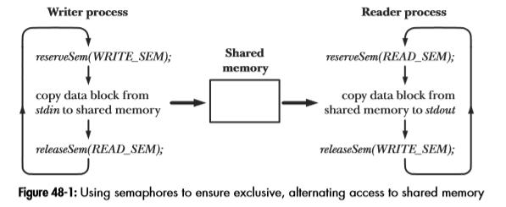
Example of shared memory

Slide 20
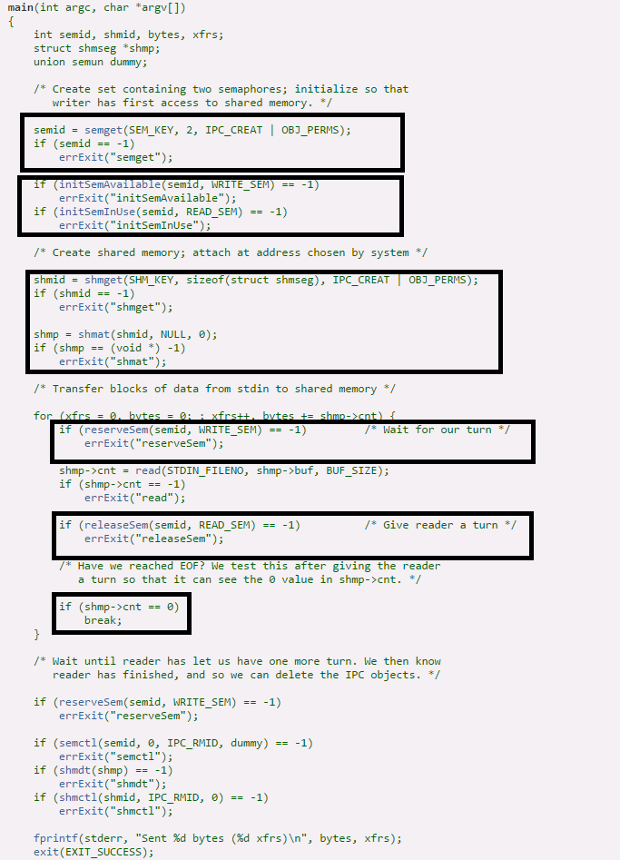
Example of shared memory – Writer (P 1003 in LPI book)
Declare shared memory segment
Create semaphore array of 2 elements
Initialize semaphores
Create and
attach shared
memory
Wait for
Writer turn
Give Reader
a turn

Slide 21
Side note on following code: (1 of 2)
It uses “union” which is like a structure.
A structure is an object consisting of a sequence of named members of various types.
A union is an object that contains, at different times, any one of several members of various types.
The following code is from: #include "semun.h“
union semun { /* Used in calls to semctl() */
int val;
struct semid_ds * buf;
unsigned short * array;
#if defined(__linux__)
struct seminfo * __buf;
#endif
};

Slide 22
Side note on following code: (2 of 2)
I found more information with a Google search.
“In c, the difference between struct and union”
Here are links to two articles with more information.
http://cs-fundamentals.com/tech-interview/c/difference-between-structure-and-union-in-c-language.php
https://www.tutorialgateway.org/difference-between-structure-and-union-in-c/
Also there is information in The C Programming Language by Kernighan and Ritchie. See Section A8.3, pages 212-214

Slide 23
Example of shared memory – Writer Transfer blocks of data from stdin to a system V shared memory segment (LPI, P. 1003) (1 OF 6)
/* TLPI page 1003, Listing 48-2 */
#include "semun.h"
#include "svshm_xfr.h"
int main(int agrc, char *argv[ ]) {
int semid, shmid, bytes, xfrs;
struct shmseg *shmp;
union semun dummy;
/* Create a set containing the two semaphores that are used by the writer and
reader program to ensure that they alternate in accessing the shared
memory segment. The semaphores are initialized so that the writer has
first access to the shared memory segment. Since the writer creates the
semaphore set, it must be started before the reader. */
Declare a shared memory segment

Slide 24
Example of shared memory – Writer (2 OF 6)
Create semaphore
array of 2 elements
semid = semget(SEM-KEY, 2, IPC_CREAT | OBJ_PERMS);
if (semid == -1)
errExit("semget");
if (initSemAvailable(semid, WRITE_SEM) == -1)
errExit("initSemAvailable");
if (initSemInUse(semid, READ_SEM) == -1)
errExit("initSemInUse");
/* Create the shared memory segment and attach it to the writer's virtual
address space at an address chosen by the system. */
shmid = shmget(SHM_KEY, sizeof(strut shmseg), IPC_CREAT | OBJ_PERMS);
if (shmid == -1) /* build the “pipe” before creating child process */
errExit("shmget");
shmp = shmat(shmid, NULL, 0);
if (shmp == (void *) -1)
errExit("shmat");
Initialize semaphores
Create and attach shared memory
Notes:
Pipe really is a shared memory segment.

Slide 25
Example of shared memory – Writer (3 OF 6)
/* Transfer blocks of data from stdin to shared memory */
/* Enter a loop that transfers data from standard input to the shared memory segment. */
/* The following steps are performed in each loop iteration:
Reserve (decrement) the writer semaphore.
Read data from standard input into the shared memory segment.
Release (increment) the reader semaphore. */

Slide 26
Example of shared memory – Writer (4 OF 6)
for (xfrs = 0, bytes = 0; ; xfrs++, bytes += shmp->cnt) {
if (reserveSem(semid, WRITE_SEM) == -1) errExit("reserveSem");
shmp->cnt = read(STDIN_FILENO, shmp->buf, BUF_SIZE);
if (shmp->cnt) == -1)
errExit("read");
if (releaseSem(semid, READ_SEM) == -1)
errExit ("reserveSem");
Note: The for loop has no terminating value.
Wait for Writer turn
Give for Reader turn

Slide 27
Example of shared memory – Writer (5 OF 6)
/* Have we reached EOF? We test this after giving the reader
a turn so that it can see the 0 value in shmp->cnt. */
/* The loop terminates when no further data is available from standard input. On the last pass through the loop, the writer indicates to the reader that there is no more data by passing a block of data of length 0 (shmp->cnt is 0). */
if (shmp->cnt == 0)
break;
} /* end of for loop */
When we reach 0, break out of the infinite loop

Slide 28
Example of shared memory – Writer (6 OF 6)
/* Wait until reader has let us have one more turn. We then know
reader has finished, and so we can delete the IPC objects. */
/* Upon exiting the loop, the writer once more reserves its semaphore, so that it
knows that the reader has completed the final access to the shared memory. */
if (reserveSem(semid, WRITE_SEM) == -1)
errExit("reserveSem");
/* The writer then removes the shared memory segment and semaphore set. */
if (semctl(semid, 0, IPC_RMID, dummy) == -1)
errExit("semctl");
if (shmdt(shmp) == -1)
errExit("shmdt");
if (shmctl(shmid, IPC_RMID, 0) == -1)
errExit("shmctl");
fprintf(stderr, "Send %d bytes (%d xfrs)\n", bytes, xfers);
exit(EXIT_SUCCESS);
}

Slide 29
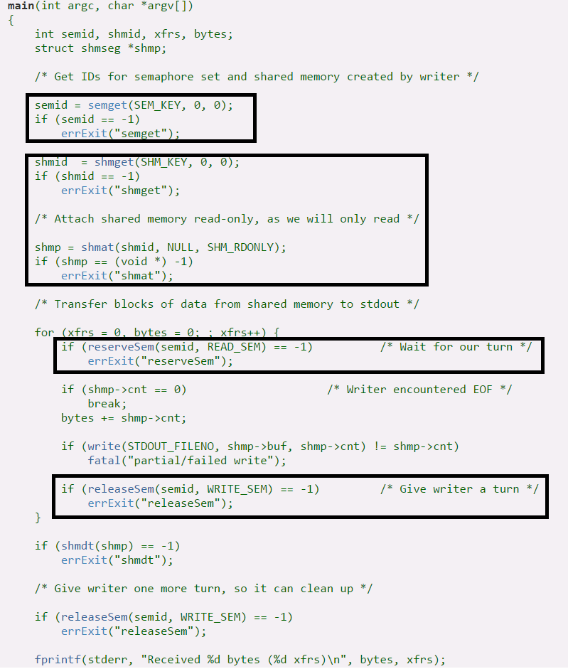
Example of shared memory – Reader (p 1005 LPI Book)
Get semaphore id
Attach shared
memory
Wait for
Reader turn
Give Writer
a turn

Slide 30
Example of shared memory – Reader Transfer blocks of data from a system V shared memory segment to stdout (LPI, P. 1005) (1 OF 4)
/* LPI page 1005, Listing 48-3 */
#include "svshm_xfr.h"
int main(int agrc, char *argv[ ]) {
int semid, shmid, bytes, xfrs;
struct shmseg *shmp;
/* Get IDs for semaphore set and shared memory created by writer */
/* Obtain the IDs of the semaphore set and shared memory segment
that were created by the writer program. */
semid = semget(SEM-KEY, 0, 0);
if (semid == -1)
errExit("semget"); // csc60/ClassExamples/svshm…
Declare a shared memory segment
Get semaphore id
Notes:
csc60/ClassExamples/svshm_xfer_writer

Slide 31
Example of shared memory – Reader (2 OF 4)
shmid = shmget(SHM_KEY, 0, 0);
if (shmid == -1)
errExit("shmget");
/* Attach the shared memory segment for read-only access. */
shmp = shmat(shmid, NULL, SHM_RDONLY);
if (shmp == (void *) -1)
errExit("shmat");
Attach shared memory

Slide 32
Example of shared memory – Reader (3 OF 4)
/* Transfer blocks of data from shared memory to stdout */
for (xfers = 0, bytes = 0; xfers++) {
if(reserveSem(semid (READ_SEM) == -1) // Wait for our turn
errExit("reserveSen");
if (shmp->cnt == 0) // Writer encountered EOF
break; // shmp-> cnt is the Read
bytes += shmp->cnt; // from memory.
if (write(STDOUT_FILENO, shmp->buf, shmp->cnt, != shmp->cnt)
fatal("partial/failed write");
if(releaseSem(semid, WRITE_SEM) == -1)
errExit("releaseSem");
} /* end of for loop */
Wait for Reader turn
Give Writer a turn

Slide 33
Example of shared memory – Reader (4 OF 4)
/* After exiting the loop, detach the shared memory segment */
if (shmdt(shmp) == -1)
errExit("shmdt");
/* Release the writer semaphore, so that the writer program can remove the
IPC objects */
/* Give writer one more turn, so it can clean up */
if (reserveSem(semid, WRITE_SEM) == -1)
errExit("reserveSem");
fprintf(stderr, "Received %d bytes (%d xfrs)\n", bytes, xfers);
exit(EXIT_SUCCESS);
}

Slide 34
Shared memory demo
Notes:
Bring up the Writer then do ^z
Bring up the Reader with &
Type jobs
%1 to bring Writer (to fg)
Type words, then Enter.
Get Echo (from Reader)
Ctrl-d (EOF) both go away.
If looking for this code in the on-line distribution, it will be in:
tlpi-dist/svshm
Writer = svshm_xfr_writer
Reader =
svshm_xfr_reader

Slide 35
Message Queues

Slide 36
Message Queue
A Message Queue is a linked list of message structures stored inside the kernel’s memory space and accessible by multiple processes
Synchronization is provided automatically by the kernel
New messages are added at the end of the queue

Slide 37
Message Queue
Each message structure has a long int message type
Messages may be obtained from the queue either in a FIFO manner (default) or by requesting a specific type of message (based on message type)

Slide 38
msgget()
This function creates a message queue
#include <sys/msg.h>
int msgget(key_t key, int msgflg);
a key value
returns a queue identifier
if successful, otherwise, -1
permission bits and
IPC_CREAT

Slide 39
msgsnd() The msgsnd() system call is used to send messages to a message queue.
#include <sys/msg.h>
int msgsnd(int msgid, const void *msg_ptr, size_t msgsize, int msgflg);
The message queue
identifier from msgget()
the message size.
Does not include
the type.
Returns 0 if successful
otherwise -1
struct my_message
{
long int message_type;
// the data to transfer
}
IPC_NOWAIT returns without sending the message if the queue is full when set. Otherwise the process waits for space to become available in the queue.

Slide 40
msgrcv()
The msgrcv() system call is used receive messages from a message queue.
#include <sys/msg.h>
int msgrcv(int msgid, void *msg_ptr, size_t msg_sz,
long int msgtype, int msgflg);
The message is copied
here. Includes the long
int.
Message size
0 if successful
otherwise -1
if 0, the next message is
retrieved. If non-zero, the
next message with this
message type is retrieved
The message
queue id
IPC_NOWAIT if set, the call will
return immediately. Otherwise, it
waits until a message of the
specified type is available to be read.

Slide 41
msgctl()
Performs the control operation specified by cmd on the message
queue with identifier msgid
#include <sys/msg.h>
int msgctl(int msgid, int command, struct msgid_ds *buf);
message queue id
0 if successful
otherwise -1
IPC_STAT loads data in msgid_ds structure
IPC_SET gets the data from the msgid_ds structure
IPC_RMID deletes the message queue

Slide 42
From the Author of our Book:
At the end of this chapter (Section 46.9), we summarize a number of limitations of System V message queues. This limitations lead us to the conclusion that, where possible, new applications should avoid the use of System V message queues in favor of other IPC mechanisms such as FIFOs, POSIX message queues, and sockets. However, when message queues were initially devised, these alternative mechanisms were unavailable or were not widespread across UNIX implementations. Consequently, there are various existing applications that employ message queues, and this fact forms one of the primary motivations for describing them.

Slide 43
FIFO’s (Alias – named pipes)
Similar to a pipe.
Differences
Has a name
Opened like a regular file
Useful for unrelated processes. Ex. Client & Server
Likenesses
Use open(), read(), write(), close()
Has a Read end and a Write end like a pipe
Info in TLPI pages 906-919

Slide 44
POSIX message queues
Likenesses to System 5 Message Queues
Data exchanged in units of whole messages
Differences
They are counted. If closed, not deleted till released by all users.
Have priority, and are queued
Process can be asynchronously notified when msg is available
Info in TLPI, Chapter 52, pages 1063-1087

Slide 45
13-UNIX
Shared Memory
Shared Memory, Message Queues
The End

